Slide 1
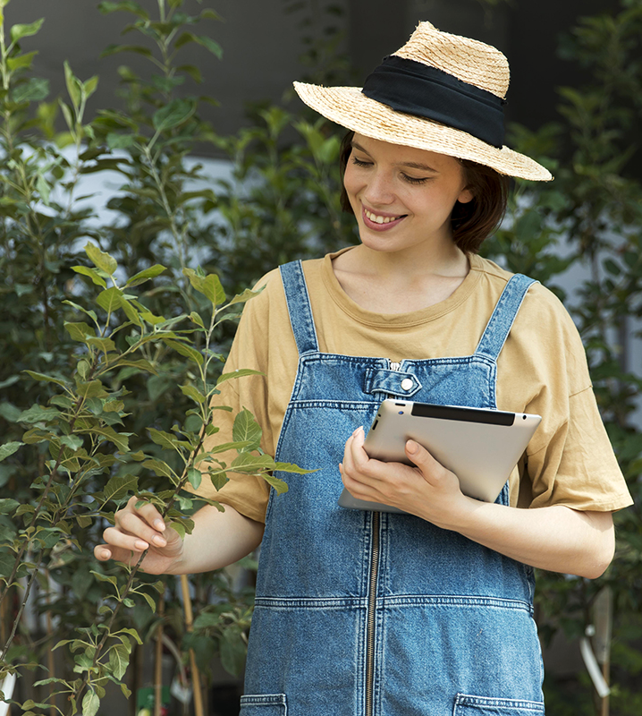
AgriEasy
HARVESTING THE FUTURE OF AGRICULTURE
Team :
Bisuraj Sharma(20BCE2923)
Sumit Kumar Mandal(20BCE2885)
Ujjwal Tiwari(20BCE0415)
Bijan Shrestha(20BCE2904)
Anish Shrestha(20BCE2893)

Slide 2
TABLE OF CONTENTS
INTRODUCTION
PROBLEM STATEMENT
01
02
03
LITERATURE SURVEY
DATASET USED
04
01
02
This Slide Give a brief introduction about the project
This slide describes the problem statement we are working on
03
04
This slide describes about dataset being used in our project
This slide summarizes the existing work
SYSTEM DESIGN &
METHODOLOGY
PERFORMANCE MEASURE
04
05
This slide Describe the methodology used and overall System Design
This slide contains the objective and subjective measures

Slide 3
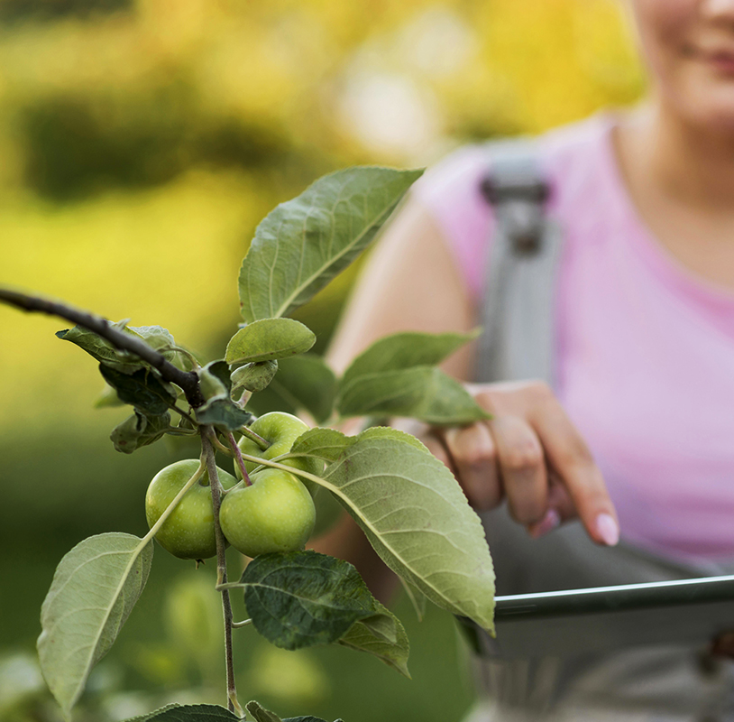
INTRODUCTION
For farmers, agriculture is essential as it is the main source of their income, giving them the ability to grow crops and raise animals for food and other items, which they can then sell to make a living.
The major cause of agricultural loss is frequently due to pests and illnesses. Plant diseases may have a big impact on agriculture, reducing overall on production or even causing total crop failure, which is expensive for farmers.
Early disease detection helps to adopt effective control measures, such as the use of pesticides or other control measures, which can help to lessen the disease's detrimental effects on crop production. Early disease detection also helps to reduce crop losses and prevent the disease from spreading to nearby plants.

Slide 4
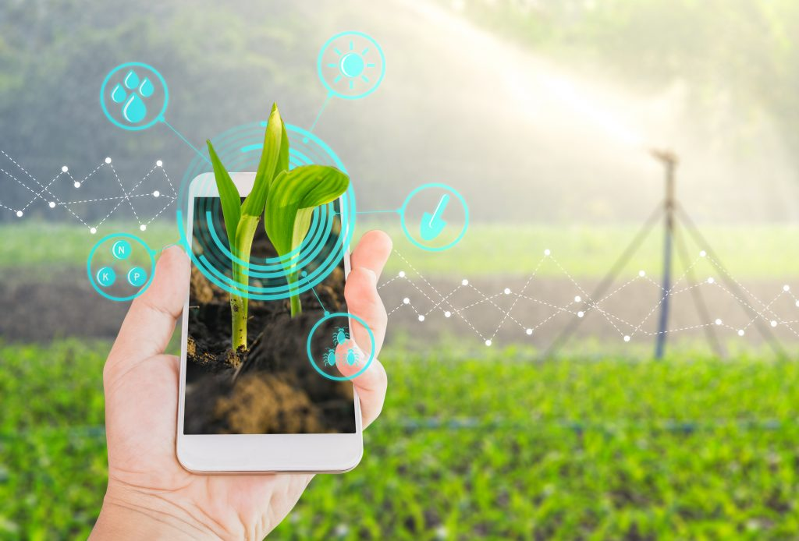
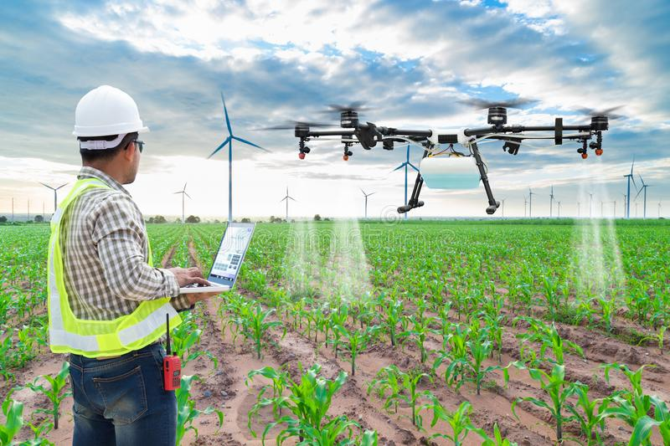
With the aim of enhancing farmers' life in terms of their financial well-being and mental health, we have created a mobile application for ease of farmers.
AgriEasy is a mobile application that provides farmers with a comprehensive suite of tools to improve their farming operations.
It can be quite difficult to manually identify the appropriate characteristics for differentiating between various forms of crop illnesses since there are so many distinct types of plant diseases.
A plant disease detection program is one of the major aspects of this application. It utilizes image recognition technologies, Machine Learning classification model, CNN model to identify and analyze common plant diseases, enabling farmers to address to the possible problems immediately.
The term "image recognition technology" describes a computer or other machine's capacity to recognize and comprehend the contents of an image or video. This is achieved through the use of machine learning algorithms, which can be trained to recognize patterns and objects within images.

Slide 5
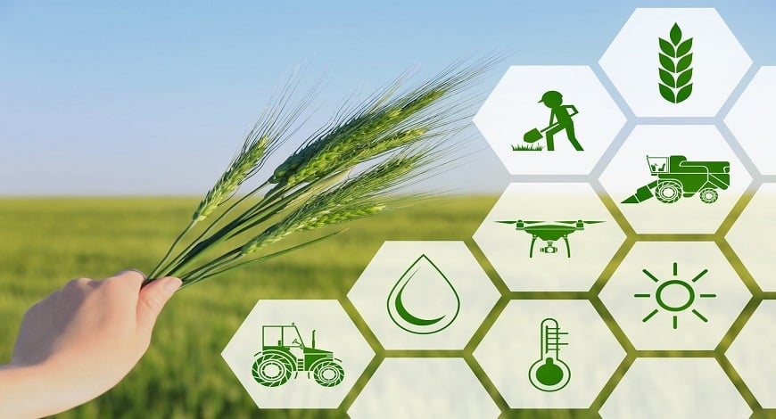
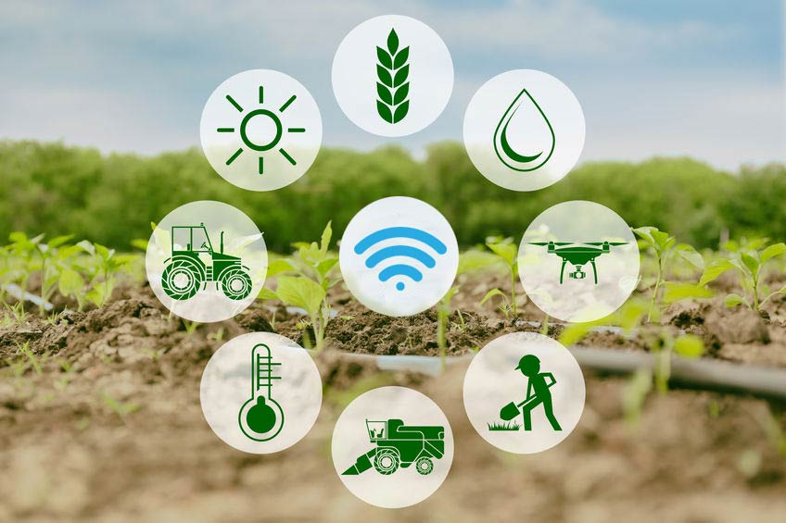
A deep learning model called a CNN (Convolutional Neural Network) image recognition model is ideally suited for picture categorization and object recognition applications. Utilizing a technique known as convolution, CNNs train their models to recognize patterns and features in pictures by examining discrete areas (or "windows") of the image at a time.
The app also provides access to the most recent news and information on agriculture, including market trends, industry developments, and government policies, helping farmers stay informed and make decisions. These additional features also provide real-time weather monitoring, evaluation of planting and harvesting statistics, and real-time crop management decisions.
Overall, AgriEasy is the ideal and most important tool for farmers, providing them the resources they require to improve their yields and agricultural production efficiency.

Slide 6
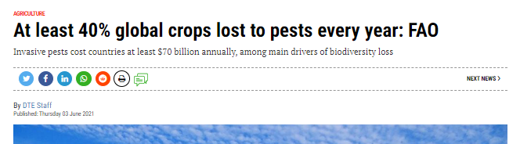
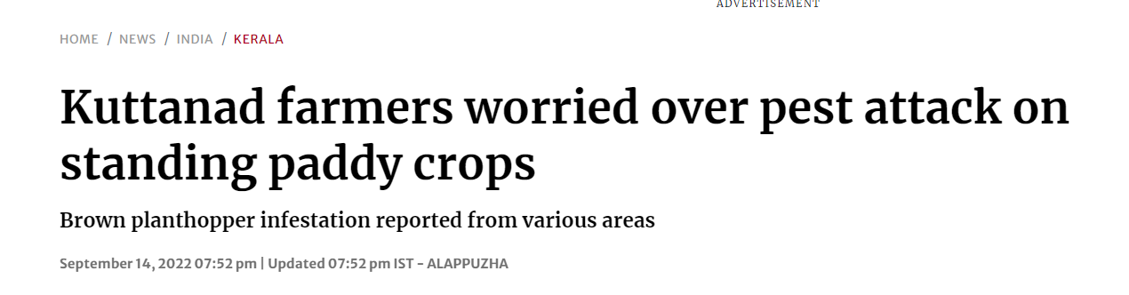

PROBLEM STATEMENT
A recent report estimates that invasive pests cost countries at least $70 billion annually and that as much as 40% of the world's agricultural crops are lost to pests each year.
Improved monitoring and surveillance systems as well as more eco-friendly and comprehensive pest management techniques are necessary.
Objective : Develop a mobile application that offers real-time weather monitoring and other information to help farmers make informed decisions on crop management and irrigation to mitigate the impact of pests on agricultural crops, its control and detection.
Input : Image input to detect the disease on crops, various API calls to train the datasets.
Output: Detection of plant disease and pest control mechanism /suggestion, Weather forecasting and farming approach

Slide 7
LITERATURE REVIEW
S.N. | Paper Name | Author and Published Date | Methodology | Dataset | Evaluation Metrics | Objectives and Limitation
1. | An app to assist farmers in the identification of diseases and pests of coffee leaves using deep learning | Jose´ G.M. Esgario , Pedro B.C. de Castro , Lucas M. Tassis , Renato A. Krohling 18 jan 2021 https://doi.org/10.1016/j.inpa.2021.01.004 | semantic segmentation architectures, UNet and Pyramid Scene Parsing Networks (PSPNet) | Segmentation dataset Symptoms dataset | accuracy (AC), precision (PR), and recall (RE) Cited by 12 | This app provides a tool for growers for diagnosis of pests and diseases in coffee leaves using their smartphones. A limitation, the framework would be the need for internet access for its operation.

Slide 8
LITERATURE SURVEY
2. | AgriCare: An Android Application for Detection of Paddy Diseases | Rounak Talreja Varsha Jawrani Bhajan Watwani Dr. Sharmila Sengupta Prium Rohera Dr. K. S. Raghuwanshi 15 july 2022 https://ieeexplore.ieee.org/document/9825038 | Wireframing of the application for design , cloud technology and CNN model for disease prediction. | Infected paddy plant leaves and cleaned paddy plant leaves. | Accuracy(AC), Training time. Cited by 16 | Improve the usability of the system by allowing limited-resource farmers to detect plant diseases at an early stage and eliminate incorrect fertilizer using which can harm the soil and plants. -Limitation of datasets and could not identify the infected leaf well with low quality camera phone.
3. | Plant disease identification from individual lesions and spots using deep learning | Jayme Garcia, Arnal Barbedo April 2019 https://doi.org/10.1016/j.biosystemseng.2019.02.002 | Transfer learning was applied to a pretrained GoogLeNet CNN using Matlab, Neural Network Toolbox (version 2017b). The GoogLeNet architecture was chosen because of its superior performance in the context of plant disease recognition | Image dataset of different plants using different sensors. | Accuracy(AC), Processing Time. Cited by 285 | Accuracy improved by 12% using the proposed approach. Limitation is however the huge processing time of data sets and limited datasets.

Slide 9
LITERATURE SURVEY
4. | Plant Disease Detection and Classification by Deep Learning | Muhammad Hammad Saleem ,Johan Potgieter and Khalid Mahmood Arif 31 October 2019 https://doi.org/10.3390/plants8110468 | Plant Disease Detection by Well-Known DL Techniques, Without Visualization Technique and With Visualization Technique | Plant leaf dataset along with disease datasets | Accuracy(AC) Cited by 283 | This review explained DL approaches for the detection of plant diseases. Moreover, many visualization techniques/mappings were summarized to recognize the symptoms of diseases. Although this dataset has a lot of images of several plant species with their diseases, it has a simple/plain background. However, for a practical scenario, the real environment should be considered.
5. | IoT-based data logger for weather monitoring using arduino-based wireless sensor networks with remote graphical application and alerts | Jamal Mabrouki; Mourade Azrour; Driss Dhiba; Yousef Farhaoui; Souad El Hajjaji March 2021 10.26599/BDMA.2020.9020018 | IOT monitoring using different sensor (Humidity, Temperature) | In this paper the hardware devices like wifi module, Arduino UNO and sensors like temperature and humidity sensors are required. | Cited by 53 | The main objective of this system is sensing the climate parameters, such as temperature, humidity, and existence of some gases, based on the sensors. The captured values can then be sent to remote applications or databases. Afterwards, the stored data can be visualized in graphics and tables form. Limitation is the defective sensors that measures fault data

Slide 10
LITERATURE SURVEY
6. | Modelling the impacts of pests and diseases on agricultural systems | M.Donatelli R.D.Magarey S.Bregaglio L.Willocquet P.M.WhishdS.Savary July 2017 https://doi.org/10.1016/j.agsy.2017.01.019 | Building process models to calculate different layer variation of air temperature, precipitation, relative humidity that impacts agricultural systems. | Common inputs for PDM are air temperature, precipitation, relative humidity, and leaf wetness at daily or hourly resolution. | Cited by 182 | The objective of this paper is to present an analysis of the technical and scientific challenges in the development of process-based models for pest and disease modelling, and a possible road map to improve their capability for estimating impacts on agricultural production. lack of reference data and the need to improve the robustness and applicability of simulation models over such conditions.
7. | Climate change: potential impact on plant diseases | SChakraborty. A.VTiedemann P.STeng June 2000 https://doi.org/10.1016/S0269-7491(99)00210-9 | Models uses different climatic variables to predicts the potential impact on plant diseases. | Diseases of plants on different climatic conditions due to changing climate. | Cited by 284 | To study the potential impacts of climate change in plant diseases and their affect on economics of country This paper is limited to just impacts of climate change and their affects on plants.

Slide 11
LITERATURE SURVEY
8. | MDFC–ResNet: An Agricultural IoT System to Accurately Recognize Crop Diseases | Wei-Jian Hu; Jie Fan; Yong-Xing Du; Bao-Shan Li; Naixue Xiong; Ernst Bekkering 9 June 2020 10.1109/ACCESS.2020.3001237 | IoT technology with deep learning to build an IoT system for crop fine-grained disease identification. SVD, multidimensional feature compensation residual neural network (MDFC-ResNet) model is used for fine-grained disease identification in the system. MDFC-ResNet that identifies from three dimensions, namely, species, coarse-grained disease, and fine-grained disease and sets up a compensation layer that uses a compensation algorithm to fuse multidimensional recognition results. | Datasets of plant leaves at extreme diseased condition and healthy leaves of same plants to detect different layes of diseases. | Accuracy (AC) Cited by 31 | To use IOT systems with deep learning models to differentiate diseases and their layers. However, the limited datasets might show less accuracy of predicted disease.

Slide 12
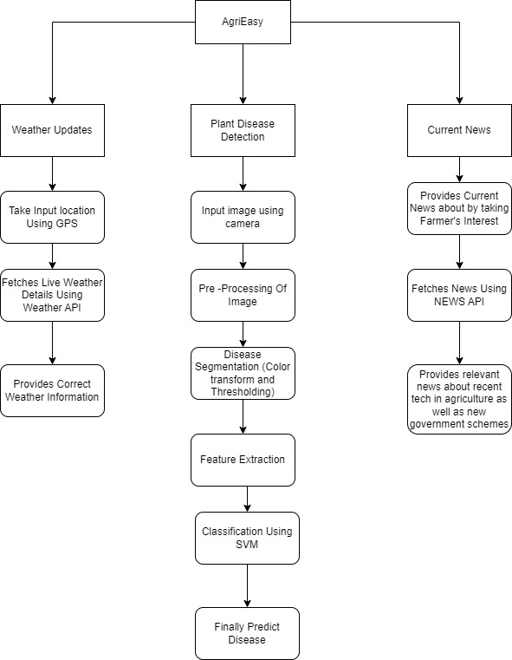
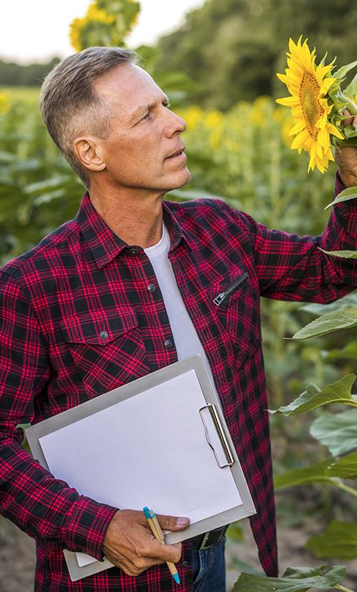

AgriEasy
AgriEasy have 3 modules :
Weather : It Fetches Current weather by fetching current location data .
Disease Detection: This is the main module in our whole application it uses Image Recognigtion Technology as well as ML for classification of images.It takes input as image from the user then pre process the image to remove the noise and uses color transform for disease segmentation and finally uses SVM for Classification of Disease and finally predict the disease
News: It Fetches News that is relevant to farmes including latest trends in agriculture as well as recent government schemes for farmers

Slide 13
DATASET USED
In this data-set:
A total of 2,941 diseased plant images that consists of 6 disease categories were used:
Corn Common Rust (500 images)
Corn Gray Leaf Spot (441 images)
Potato Early Blight (500 images)
Strawberry Leaf Scorch (500 images)
Tomato Leaf Mold (500 images)
Tomato Mosaic Virus (500 images)
https://data.mendeley.com/datasets/tywbtsjrjv/1
DATSETS SOURCE:

Slide 14
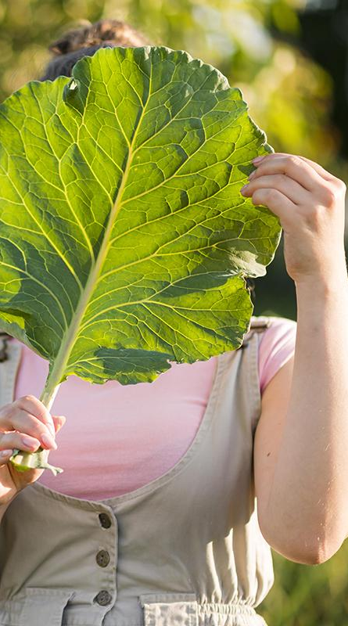
Features
WEATHER UPDATES
PLANT DISEASE DETECTION
It give your current updates about weather of current location such that to get updated with it
It has one main feature which help farmers to detect plant disease using our app
CURRENT NEWS
USER FRIENDLY
It keeps farmer updated with recent agriculture news and government schemes
It is user friendly and can easily be used by any farmer and supports multiple language

Slide 15
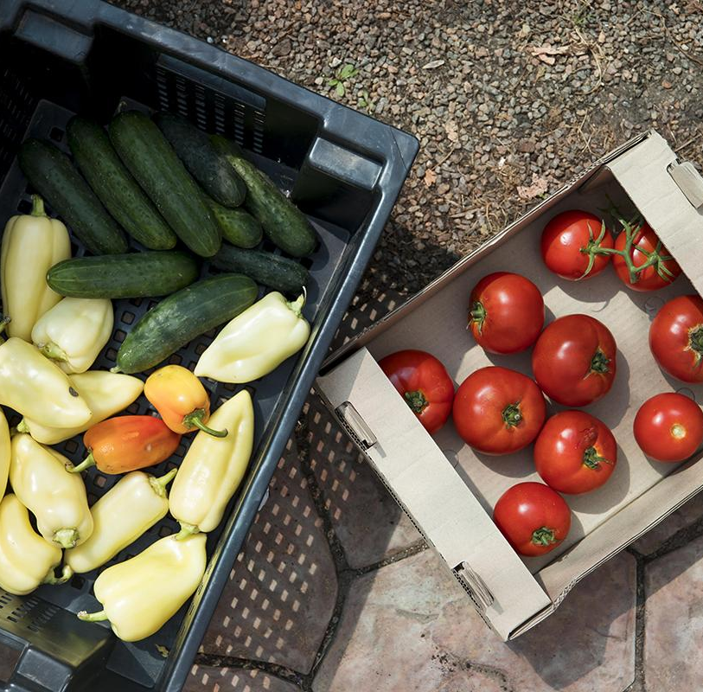
PERFORMANCE MEASURE
Objective Measures
User engagement
Adoption rate
Task completion rate
Accuracy
Feedback and reviews

Slide 16
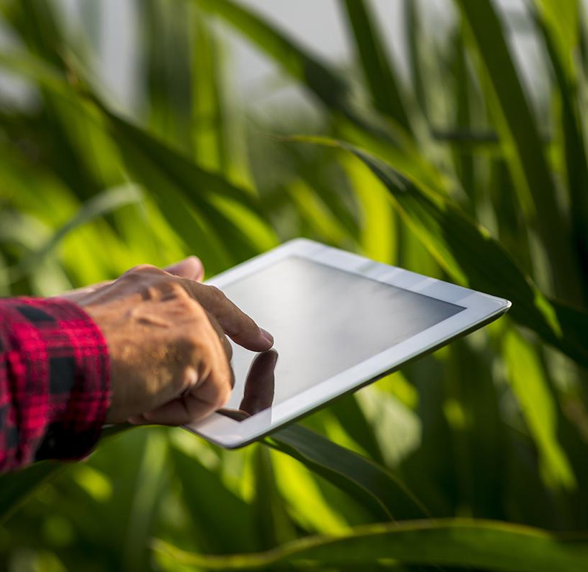
PERFORMANCE MEASURE
Subjective measures
User satisfaction
User experience
Perceived ease of use
Usability
User feedback

Slide 17
Methodology Used
Transfer Learning : Using Resnet 50
Transfer Learning : Using Resnet 50

Slide 18
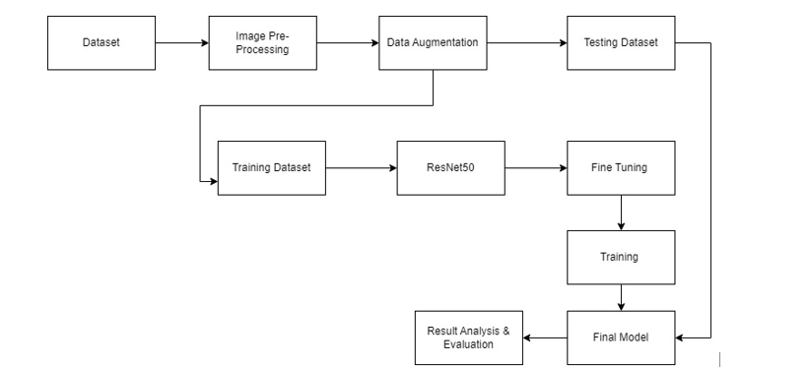
Proposed Methodology
Block Diagram

Slide 19
Proposed Methodology
Dataset
We are using the “PlantVillage dataset”,[15] which is a publicly available dataset containing images of diseased and healthy plant leaves. The dataset includes images of 38 different plant species, each with multiple categories of disease, as well as images of healthy leaves.
Image Pre-Processing
Image Pre-Processing enhances the picture data required for image categorization. In the Pre-Processing processes, we have scaled down all the photos' resolutions to 256*256 pixels. Then data rescaling can normalize the pixel values of images from the range [0, 255] to [0, 1], making it easier for the model to learn and reducing the impact of outliers.
Data Augmentation
We first define a set of data augmentation parameters and specify a range of random transformations to apply to the input images, including rotations, translations, shears, zooms, and flips. We also specify the fill mode to use when creating new pixels to fill in any empty space that may be created by the transformations.

Slide 20
Continue...
Data Splitting
The data is initially divided in half. With percentage ratios of 80% for the training data and 20% validation data, respectively, they are presented first. To assess if the model is overfitting, the training data is further divided into training and validation data with ratios of 80% and 20%, respectively. 34,727 samples made up the training set, 8702 samples made up the validation set, and 10,876 samples made up the testing set.

Slide 21
Resnet Architecture
A 7×7 kernel convolution alongside 64 other kernels with a 2-sized stride.
A max pooling layer with a 2-sized stride.
9 more layers 3×3,64 kernel convolution, another with 1×1,64 kernels, and a third with 1×1,256 kernels. These 3 layers are repeated 3 times.
12 more layers with 1×1,128 kernels, 3×3,128 kernels, and 1×1,512 kernels, iterated 4 times.
18 more layers with 1×1,256 cores, and 2 cores 3×3,256 and 1×1,1024, iterated 6 times.
9 more layers with 1×1,512 cores, 3×3,512 cores, and 1×1,2048 cores iterated 3 times (up to this point the network has 50 layers)

Slide 22
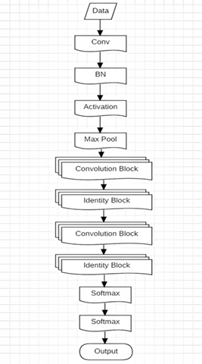
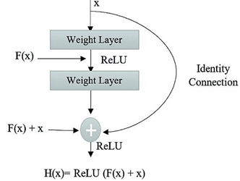
Architectures
A network-in-network (NIN) architecture called ResNet is relying on a large number of stacked residual units. The network was built using this set of residual units as its building pieces. Building blocks that make up the ResNet Architecture are made up of a group of residual units. The convolution, pooling, and layer components make up the residual units.

Slide 23
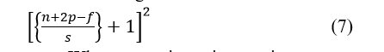
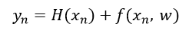
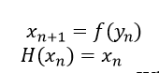
Calculations in resnet
Each residual unit can be expressed as:
To determine the size of output:
For n residual unit :
Where :
H(x) - identifying mapping of ReLU
F(Yn) - residual function of nth unit
Xn – input
N – image size
P – padding
F – no. Of filters
S - stride

Slide 24
Models Used :
Normal CNN model
Inception V3
VGGNET
Resnet 50
Resnet 50 – Tranfer Learning

Slide 25
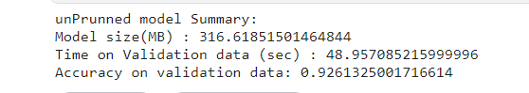
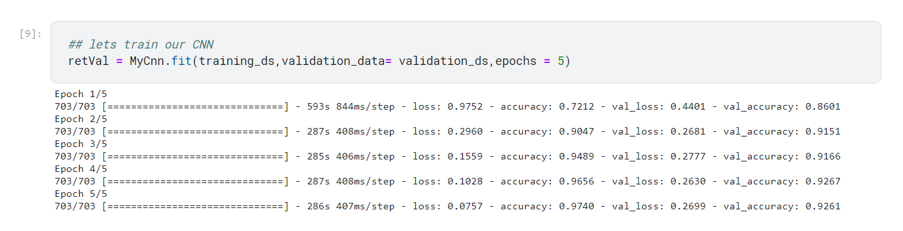
Normal CNN Model

Slide 26
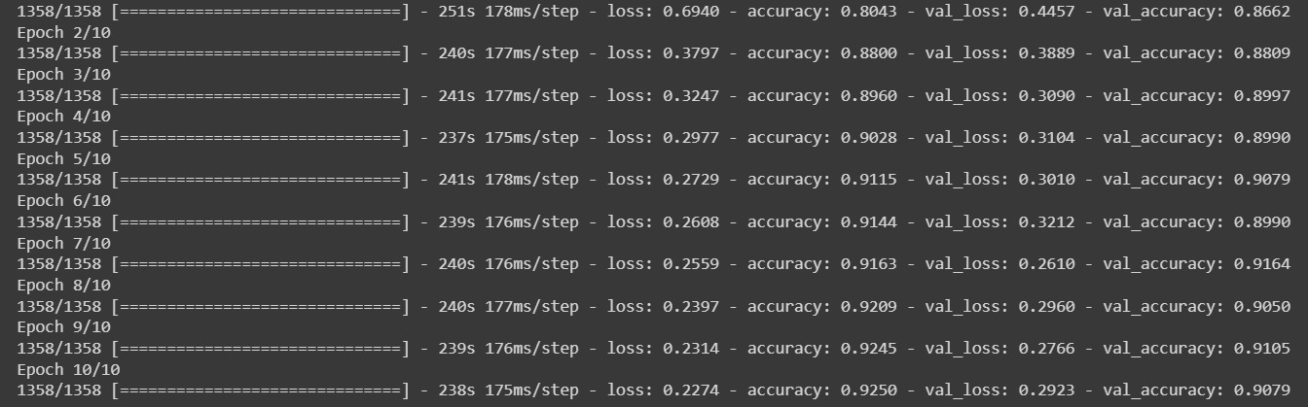
Inception V3

Slide 27
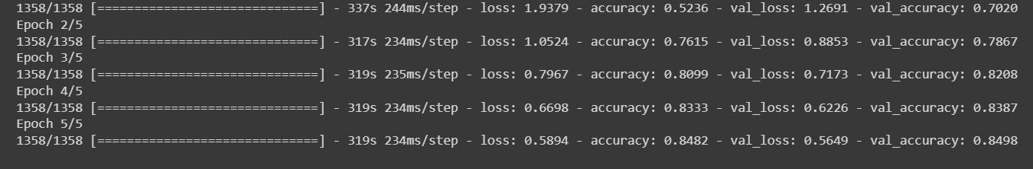
VGGNET

Slide 28
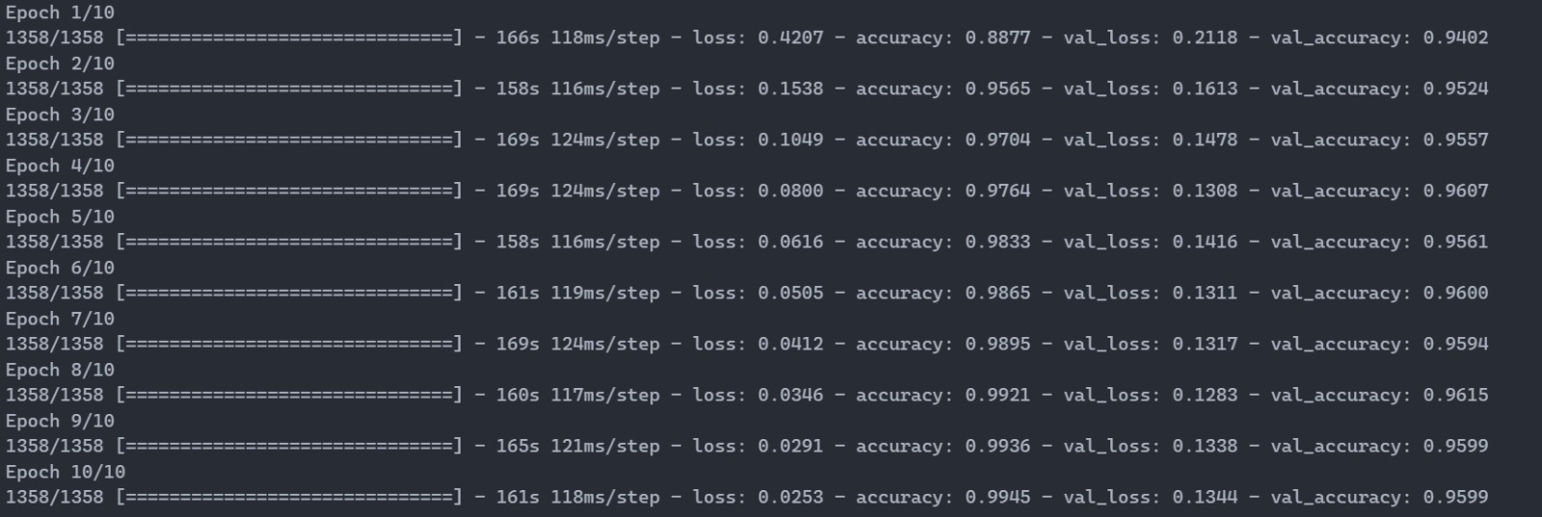
Renet-50

Slide 29
Renet-50 – Final Model(Transfer Learning)

Slide 30
Loss & Accuracy Table
S.N | Model | Loss | Accuracy | Validation Loss | Validation Accuracy
1 | Normal CNN model | 0.0757 | 0.9740 | 0.2699 | 0.9261
2 | Inception V3 | 0.2274 | 0.9250 | 0.2923 | 0.9079
3 | VGGNET | 0.5894 | 0.8482 | 0.5469 | 0.8498
4 | Resnet 50 | 0.0253 | 0.9945 | 0.1344 | 0.9599
5. | Resnet50(transfer Learning)

Slide 31
Loss & Accuracy Table
S.N | Model | Loss | Accuracy | Validation Loss | Validation Accuracy
1 | Normal CNN model | 0.0757 | 0.9740 | 0.2699 | 0.9261
2 | Inception V3 | 0.2274 | 0.9250 | 0.2923 | 0.9079
3 | VGGNET | 0.5894 | 0.8482 | 0.5469 | 0.8498
4 | Resnet 50 | 0.0253 | 0.9945 | 0.1344 | 0.9599
5. | Resnet50(transfer Learning)

Slide 32
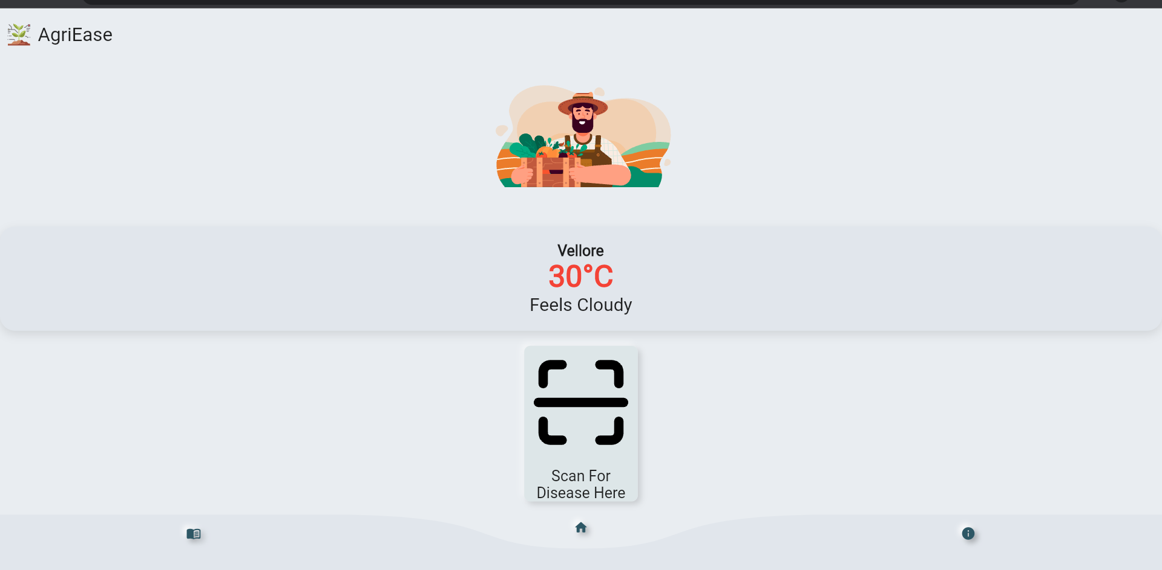
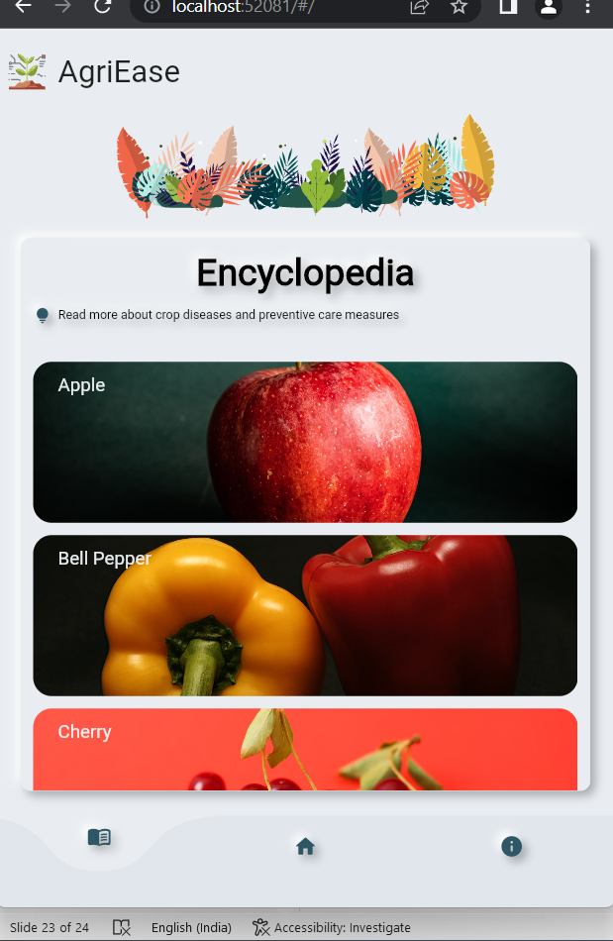
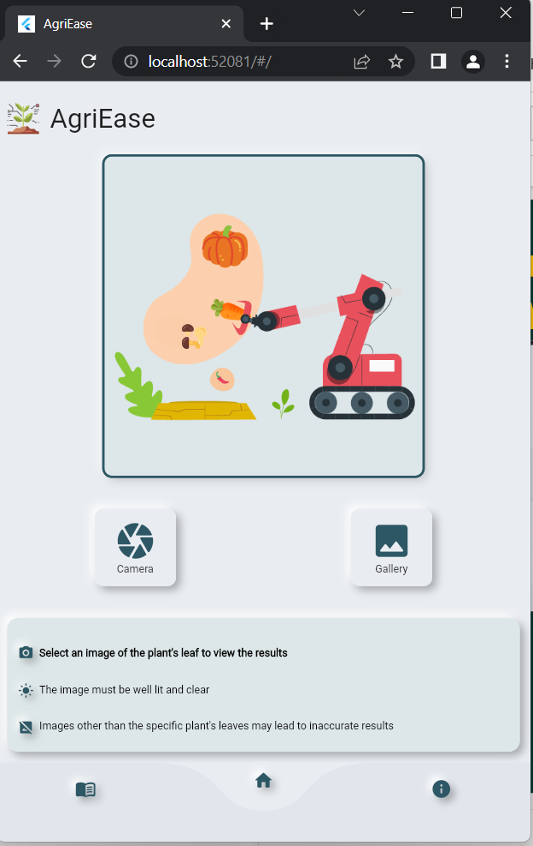
App-UI

Slide 33
THANK
YOU

